Slide 1

HUMAN ACTIVITY CLASSIFICATION USING INERTIAL MEASUREMENT DATA DEVICE
Presented By:-
Nikhil Kumar - 11037894 nikhil.kumar@stud.hochschule-heidelberg.de
Under the Guidance of Professor
Dr. Ing Milan Gnjatovic

Slide 2

INTRODUCTION
Project Focus: The project aims to classify human cooking activities based on time-series data collected from a single IMU sensor (ID 2796), used by 38 subjects performing five different recipes: brownies, pizza, sandwich, salad, and scrambled eggs.
Inertial Measurement Units (IMUs): IMUs, like the sensor (ID 2796) used in this project, measure acceleration, angular velocity, and magnetic fields, providing motion and orientation data for activity recognition tasks.
Dataset: The CMU Multimodal Activity Database (CMU-MMAC) was used, containing sensor data that includes accelerometer, gyroscope, and magnetometer readings for the different recipes.
Recurrent Neural Networks (RNNs): RNNs are chosen for their ability to process sequential data, making them suitable for classifying time-series data like sensor readings from cooking activities.
Goal: The project aims to accurately classify cooking activities based on motion data using deep learning models, demonstrating the application of IMU sensors in activity recognition.

Slide 3
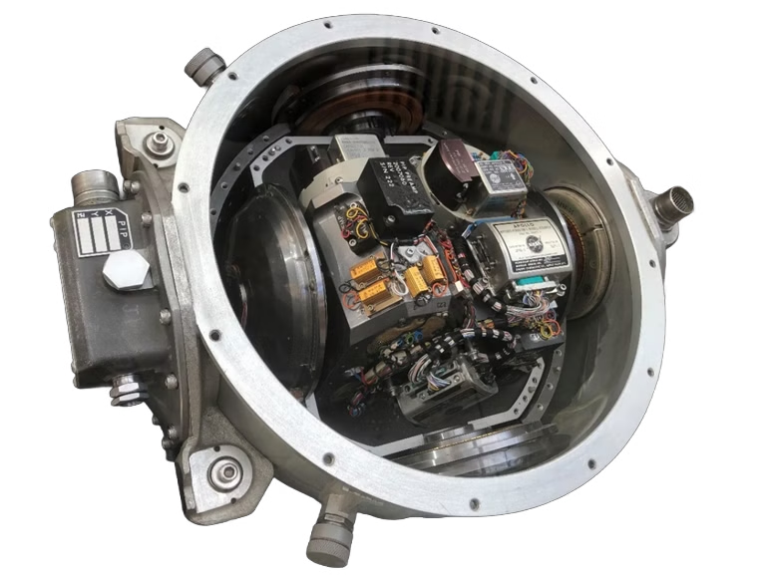
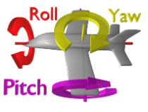
Inertial Measurement Unit Device
An inertial measurement unit (IMU) is an electronic device that measures and reports a body's specific force, angular rate, and sometimes the orientation of the body, using a combination of accelerometers, gyroscopes, and sometimes magnetometers
IMUs are typically used to maneuver modern vehicles including motorcycles, missiles, aircraft (an attitude and heading reference system), including uncrewed aerial vehicles
Accelerometer: Measures linear acceleration along X, Y, and Z axes, capturing movement speed and direction like stirring or chopping or mixing by recording the force applied in different directions.
Gyroscope: Measures angular velocity, detecting rotational movements such as wrist rotations or flipping ingredients, actions like flipping a sandwich or whisking ingredients in a bowl.
Magnetometer: (If present) Measures the magnetic field for orientation correction, acting like a compass to reduce drift.
Pitch(Y), Roll(X), Yaw(Z): Describe rotational movements around the X, Y, Z axes, like an airplane’s nose tilting, wings dipping, or turning left-right.

Slide 4
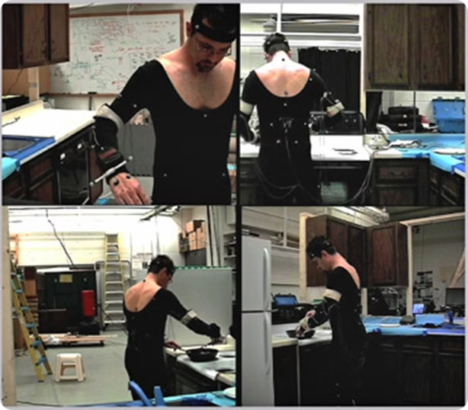
CMU-MMAC Dataset
The Carnegie Mellon University Multimodal Activity Database (CMU-MMAC) includes multimodal data on human activities, specifically focusing on cooking tasks performed by subjects in a controlled kitchen environment.
Data Collection Environment: Collected in Carnegie Mellon’s Motion Capture Lab, the dataset captures real-world interactions with kitchen tools and appliances, reflecting authentic human behavior.
Subjects and Recipes: In total, 44 subjects recorded their cooking activities while preparing five different recipes: brownies, pizza, sandwich, salad, and scrambled eggs.
Sensor Utilization: The dataset comprises recordings from 44 subjects, with various sensors (accelerometers, gyroscopes, magnetometers) placed on different body parts to measure body movements and orientation during cooking.
Activity Segmentation: Activities are segmented into phases of the cooking process, providing detailed insights into actions such as stirring, chopping, and mixing.
Focus of This Project: This project utilizes a subset of the CMU-MMAC dataset, specifically focusing on data from a single IMU sensor (ID 2796) worn by 38 subjects.
Objective: The aim is to classify the recipes based on motion patterns identified in the sensor data, exploring how machine learning techniques can effectively recognize and distinguish between different cooking activities.

Slide 5

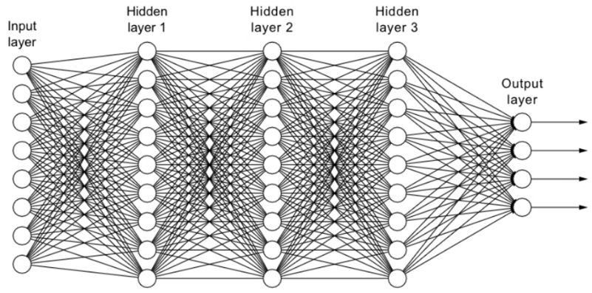
Neural Networks
Neural networks are a type of machine learning algorithm inspired by the structure and function of the human brain. They consist of interconnected nodes, called neurons, organized in layers. Each neuron receives input from other neurons, processes it, and outputs a signal. The connections between neurons have associated weights, which are adjusted during training to improve the network's performance.
Neural networks are powerful tools for various tasks, including image recognition, natural language processing, and predictive modeling. They excel at learning complex patterns from data and can handle high-dimensional inputs. The architecture of a neural network, including the number of layers and neurons, is designed to suit the specific problem being addressed.

Slide 6
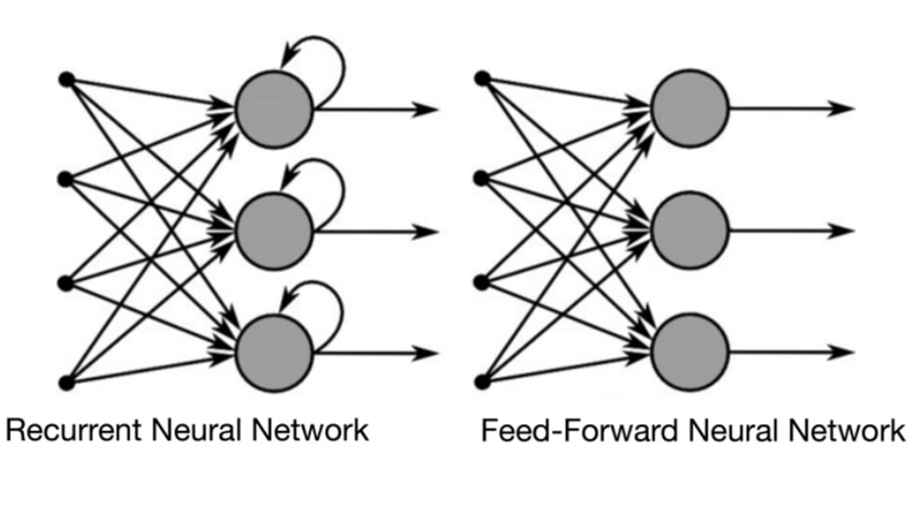

Recurrent Neural Networks (RNNs)
Recurrent Neural Networks (RNNs) were introduced to address the limitations of traditional neural networks, such as FeedForward Neural Networks (FNNs), when it comes to processing sequential data.
FNN takes inputs and process each input independently through a number of hidden layers without considering the order and context of other inputs.
Recurrent neural networks (RNNs) are the state-of-the-art algorithm for sequential data and are used by Apple’s Siri and Google’s voice search. It is the first algorithm that remembers its input, due to an internal memory.
Because of their internal memory, RNNs can remember important things about the input they received, which allows them to be very precise in predicting what’s coming next.
Simply put: Recurrent neural networks add the immediate past to the present.
Think of it like a "memory-keeping" calculator that not only processes the current data but also remembers what it has seen before.

Slide 7




Recurrent Neural Network (RNN) Model Architecture
A Recurrent Neural Network (RNN) was chosen as the machine learning model to classify the activities performed in the kitchen. RNNs are well-suited for analyzing sequential data like sensor readings.
Input Layer
Recurrent Layer
Hidden(Dense) Layers
Output Layer
This is where the input data is fed into the model. Each input is processed one step at a time, like feeding words from a sentence or steps from a time series.
The RNN has a special connection that helps it “remember” information from previous steps. At each step, it combines what it learned from the past with the new input to make better predictions. (Simple RNN, LSTM ,BiLSTM , GRU)
This is the memory of the RNN. It stores what the model has learned from the previous inputs and gets updated with each new input.
This is where the model gives its output based on the current input and what it has remembered so far (hidden state).

Slide 8
Why Choose Recurrent Neural Networks (RNNs)?
Recurrent Neural Networks (RNNs) are designed for handling sequences, making them ideal when the order of inputs matters. Unlike regular neural networks, RNNs remember previous inputs, allowing them to use past information to influence current decisions. This is crucial for tasks like time-series data, language processing, and activities where actions depend on what happened earlier.
For example, in recipe classification, movements made at one moment depend on earlier actions. RNNs can capture these connections better than networks that treat each input separately.
In short, RNNs are perfect for problems where patterns unfold over time, like speech recognition, activity recognition, and sensor-based classification.

Slide 9
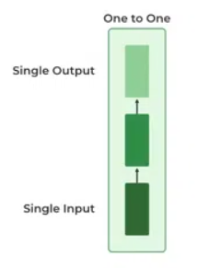
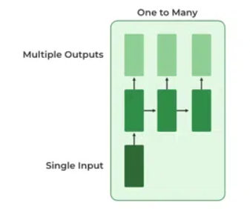
Types Of Recurrent Neural Network
One to One:
This type of RNN behaves the same as any simple Neural network it is also known as Vanilla Neural Network. In this Neural network, there is only one input and one output.
One To Many:
In this type of RNN, there is one input and many outputs associated with it. One of the most used examples of this network is Image captioning where given an image we predict a sentence having Multiple words.

Slide 10
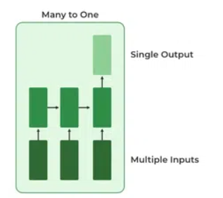
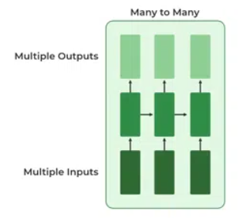
Types Of Recurrent Neural Network
Many to One:
In this type of network, Many inputs are fed to the network at several states of the network generating only one output. This type of network is used in the problems like sentimental analysis. Where we give multiple words as input and predict only the sentiment of the sentence as output.
Many to Many:
In this type of neural network, there are multiple inputs and multiple outputs corresponding to a problem. One example of this problem will be language translation. In language translation, we provide multiple words from one language as input and predict multiple words from the second language as output.

Slide 11
Variants of Recurrent Neural Network Architecture
Simple RNN (Recurrent Neural Network)
A Simple RNN is a basic neural network designed to process sequences of data, like time series or sentences. Unlike regular networks, it has a "memory" that allows it to remember information from previous steps.
At each step:
The current input updates the hidden state (which stores past information).
The hidden state helps produce the output and is passed to the next step.
However, Simple RNNs struggle with long sequences because they tend to forget earlier information (a problem called "vanishing gradients"). More advanced models like LSTM and GRU solve this by better retaining long-term information.

Slide 12
Variants of Recurrent Neural Network Architecture
Long Short-Term Memory Networks (LSTM)
LSTM networks are a type of RNN designed to remember information over long sequences, solving the problem traditional RNNs have with forgetting earlier inputs and it’s designed to handle both long and short-term information in sequences.
LSTMs use special memory cells or blocks controlled by three gates:
Input Gate: Decides what new information to store.
Forget Gate: Determines what information to discard.
Output Gate: Controls what information is used for the current output.
Long-Term Memory: LSTM can remember important information for a long time, unlike regular RNNs, which forget things quickly when dealing with long sequences.
Short-Term Memory: At the same time, LSTM knows when to forget less important details. It uses special gates (like filters) to decide which information to keep and which to discard.
So, LSTM is called "Long Short-Term Memory" because it can balance remembering things for both a long time and a short time, depending on what’s useful for the task.

Slide 13
Variants of Recurrent Neural Network Architecture
Bidirectional Long Short-Term Memory (BiLSTM)
BiLSTM enhances LSTM by processing data in both forward and backward directions simultaneously. It uses two LSTM layers:
Forward LSTM: Processes the sequence from start to finish.
Backward LSTM: Processes the sequence from end to start.
The outputs from both directions are then combined, allowing BiLSTM to capture both past and future context, making it more effective in tasks like speech recognition, language translation, and time-series analysis where full context is crucial. These two layers run at the same time and then combine their results. This way, the BiLSTM has a fuller picture of the sequence because it has seen both what came before and what came after the current step.
BiLSTM enhances the LSTM by processing sequences in both directions - giving it the ability to look at both past and future data - making it more accurate in tasks where full context is important

Slide 14
Variants of Recurrent Neural Network Architecture
Gated Recurrent Units (GRU)
GRUs simplify LSTM by combining the memory and hidden state into a single unit, controlled by two gates:
Update Gate: Decides how much of the past information to retain and how much new information to add.
Reset Gate: Determines how much past information to ignore.
GRUs are faster and more computationally efficient than LSTMs since they have fewer parameters. They perform well in tasks like speech recognition and text generation, where learning long-term dependencies is important but computational efficiency is key.
Main Difference between LSTM and GRU:
LSTM uses three gates (input, forget, output) and separate memory and hidden states, allowing more control
over information.
GRU uses only two gates (update, reset) and combines memory with the hidden state, making it simpler and
faster.
Why GRU was Introduced: GRU was introduced to provide a more efficient, less complex alternative to LSTM, suitable for applications that need faster training and inference while still handling long-term dependencies effectively.
Speed and computational efficiency were significant reasons for introducing GRUs
Simplified Architecture , Less Data Requirement (dataset isn't very large) and Similar Performance

Slide 15
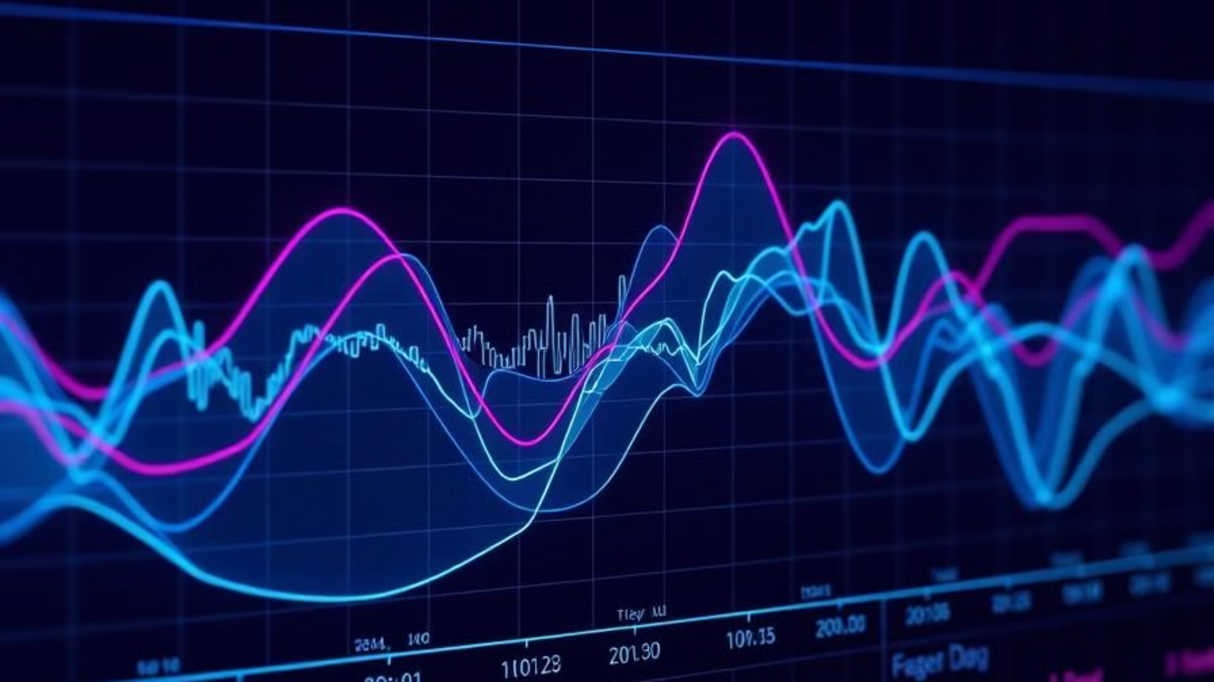
Data Preprocessing and Cleaning
The sensor data underwent preprocessing and cleaning to ensure its suitability for machine learning. This involved removing outliers,
handling missing values, and standardizing the data.
1
Load Data:
Use the load_data() function to load sensor data from text files, storing the sequences (sensor readings) in data[] and the corresponding
recipe labels in labels[].
2
Skip Metadata:
Skip the first two lines of each file, which contain metadata, and read the actual sensor data (e.g., Time, Accel_X, Accel_Y, Accel_Z) using pandas.
3
Clean Data:
Convert non-numeric values to NaN and remove rows with NaN values to keep only valid sensor readings.
4
Filter Empty Sequences:
Remove any empty or invalid data sequences to ensure only complete data is processed.
5
Ensure Consistent Features:
Remove sequences with mismatched features (e.g., different column sizes) so that all data has the same structure.
6
Pad Sequences:
Pad shorter sequences with zeros so all sequences have the same length, making them uniform for the model.
7
Scale Data:
Standardize the data using StandardScaler() to normalize sensor readings, ensuring they have a mean of 0 and a standard deviation of 1.
8
Encode Labels:
Convert recipe names (e.g., "Brownie", "Pizza") into numeric labels (e.g., 0 for Brownie, 1 for Pizza) using LabelEncoder().

Slide 16
Training the RNN Model
The RNN model was trained using a large portion of the dataset, allowing it to learn the patterns and relationships between sensor readings and kitchen activities.
Training Data
Most of the dataset was used for training, allowing the model to learn the complex
patterns in the data.
Validation/Testing Data
A separate portion of the dataset was used for validation, monitoring the model's performance
during training.
Epochs
The model was trained for multiple epochs, iterating over the training data multiple times to optimize its performance.
Loss Function
A loss function was used to measure the model's error, guiding the training process towards
minimizing errors.
Various optimizers, such as Adam or RMS_prop, were used to update the model's parameters and minimize the loss function during training. These optimizers adjust the weights and biases of the network in order to optimize the performance of the model.
Optimizers
The training data was divided into batches of a specific size. This allowed for efficient computation during training, as the model updated its parameters based on the gradients computed from each batch. Typical batch sizes used in RNN training range from 32 to 128, depending on the available computational resources and the complexity of the dataset.
Batch Size

Slide 17




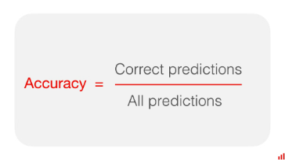
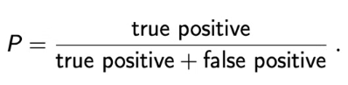
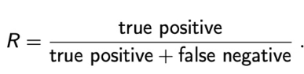
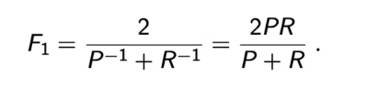
Evaluating Model Performance
The trained RNN model's performance was evaluated on a separate set of data that was not used during training, ensuring a realistic assessment of its ability to generalize to unseen data.
Accuracy
Precision
Recall
F1-Score
The accuracy of the model measures the percentage of correctly classified activities.
Precision measures the proportion of correctly classified activities among those predicted as a particular activity.
Recall measures the proportion of correctly classified activities among all actual instances of a specific activity.
The F1-score combines precision and recall into a single metric, providing a balanced measure of the model's performance.

Slide 18
My Observations in this Project
Having too many dense layers makes it harder to train the model; the best results come from having 1 to 4 layers of dense layers with a Drop out of 0.5.
NOTE: Although more neurons in the RNN layer will produce better results, due to resource constraints, more than 16 neurons could only be used in a few trials. RNNs performed well when there were more than 16 number neurons.
After multiple trials with different Optimizers like Adam, SGD, and Loss functions like – Sparse Categorical Cross entropy, and Hueber loss. The RMS-prop optimizer and Categorical Cross entropy loss function gave the best results(So Mostly Used in the project).
Also, the sequence of order in which the files are read from the dataset changes from platform to platform (IDEs)
One of the reasons for less accuracy is that the data set may have less number of files as it might be less to train the model and get good accuracy. Also as the data is from the sensors and might be prone to noise and distortion.
I Also did a special trial where I defined how much the maximum length of the sequence to be considered as the input like some percentage of the original sequence to be taken as the input for the model and I observed that the results were also the same as other trials.
After many trials and observations, I was able to determine that 47% is the project’s highest accuracy using the dataset CMU-MMAC

Slide 19

Challenges I Faced
Despite the success of the RNN model in classifying kitchen activities, there were several challenges and limitations associated with this project.
Loading and
Preprocessing the Dataset
1
2
RAM Issues:
3
Scalability
It was a challenging task to load and preprocess the large, complex dataset with multiple sensor readings, making the initial steps time-consuming and error-prone.
Processing large datasets can consume significant memory, leading to potential RAM limitations that affect execution.
Preprocessing large datasets can become computationally intensive, requiring efficient memory and time management, especially for high-frequency sensor data.
4
Sensor Noise
The presence of noise in the sensor data could introduce errors in the model's predictions, affecting its overall accuracy. Real-world sensor data often contains noise or errors that need to be cleaned, but excessive cleaning might result in loss of important information

Slide 20
Conclusion
In this project, we explored recipe classification using the CMU-MMAC dataset, leveraging advanced machine-learning techniques such as RNNs, LSTMs, and GRUs. By utilizing data from an Inertial Measurement Unit (IMU), we aimed to capture the intricate motion patterns involved in cooking activities. The results demonstrated the potential of deep learning in recognizing complex patterns within sequential data, highlighting its applicability in real-world scenarios like smart kitchens and automated cooking assistance. However, challenges such as noise and distortion in sensor readings significantly impacted the accuracy of our models, indicating the need for robust data cleaning and preprocessing techniques.

Slide 21

Future Work
The results of this study demonstrate the potential of using IMUs and RNN models for recognizing activities in a kitchen environment. However, further research is needed to address the limitations and explore new avenues for improvement.
Improved Data Collection
Data Augmentation:
Advanced Model Architectures
Real-Time Applications
Future studies could focus on collecting more comprehensive and diverse data, including recordings from a wider range of participants and activities.
Implementing techniques like synthetic data generation could help address data imbalance and enhance the model's ability to generalize
Integrating the model into real-time applications, such as smart kitchens or assistive devices, could have significant practical implications.
Exploring alternative model architectures, such as Combinations of Neural Networks like CNNs and RNNs together or transformers, could enhance the model's performance.

Slide 22


THANK YOU
Any Questions?
I am happy to answer any questions you may have.
Presented By: Nikhil Kumar - 11037894

